Slide 1
Lecture 1
STAT 451 VISUALIZING DATA
Fall 2025
Many thanks to Prof. Abel Rodriguez, many slides from this course are adapted from his data visualization class.

Slide 2
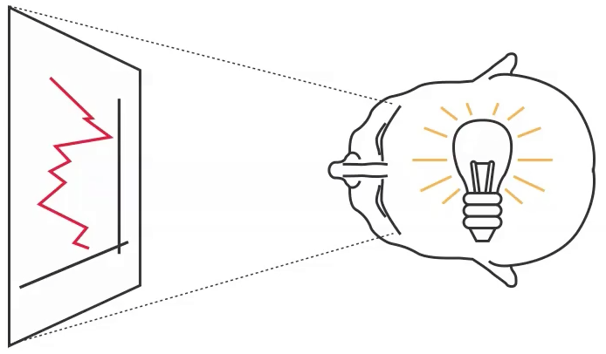
A picture is worth a 1,000 words …
Evolution has made our brains good at grasping visual cues but not so good at looking for patterns in raw numbers!

Slide 3
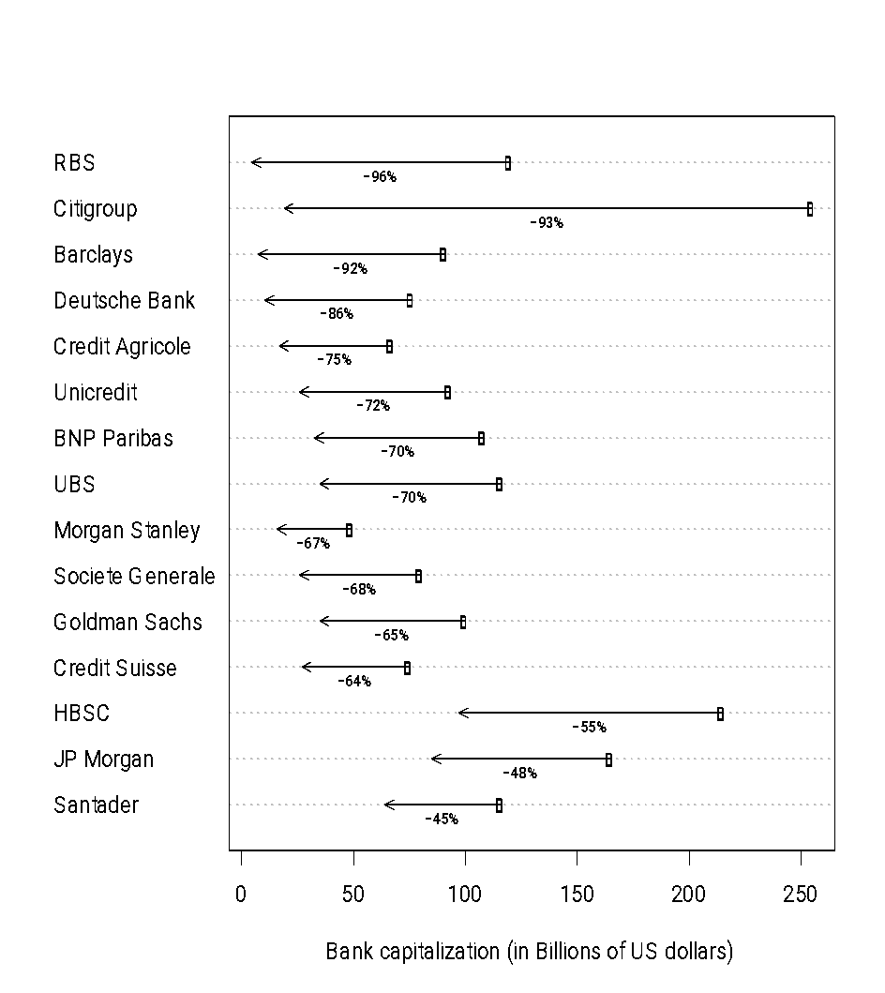
A picture is worth a 1,000 words …
Bank | January 2007 | January 2009
RBS | 120.0 | 4.6
Citigroup | 255.0 | 19.0
Barclays | 91.0 | 7.4
Deutsche Bank | 76.0 | 10.3
Credit Agricole | 67.0 | 17.0
Unicredit | 93.0 | 26.0
BNP Paribas | 108.0 | 32.5
UBS | 116.0 | 35.0
Morgan Stanley | 49.0 | 16.0
Societe Generale | 80.0 | 26.0
Goldman Sachs | 100.0 | 35.0
Credit Suisse | 75.0 | 27.0
HBSC | 215.0 | 97.0
JP Morgan | 165.0 | 85.0
Santader | 116.0 | 64.0
Graph from Alberto Cairo, The functional art, Figure 2.12.

Slide 4
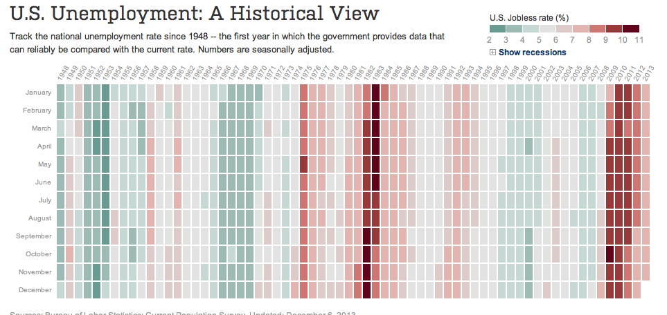
A picture is worth a 1,000 words …
Graph from Alberto Cairo, The functional art, Figure 1.11

Slide 5
A picture is worth a 1,000 words …
However, the brain is not equally good at deciphering all visual cues!
This course is about designing great visualizations!

Slide 6
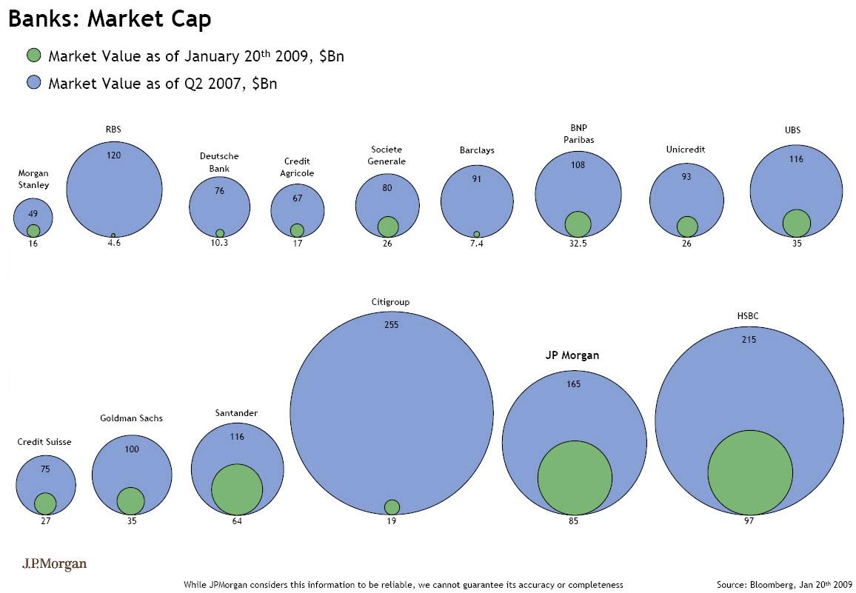
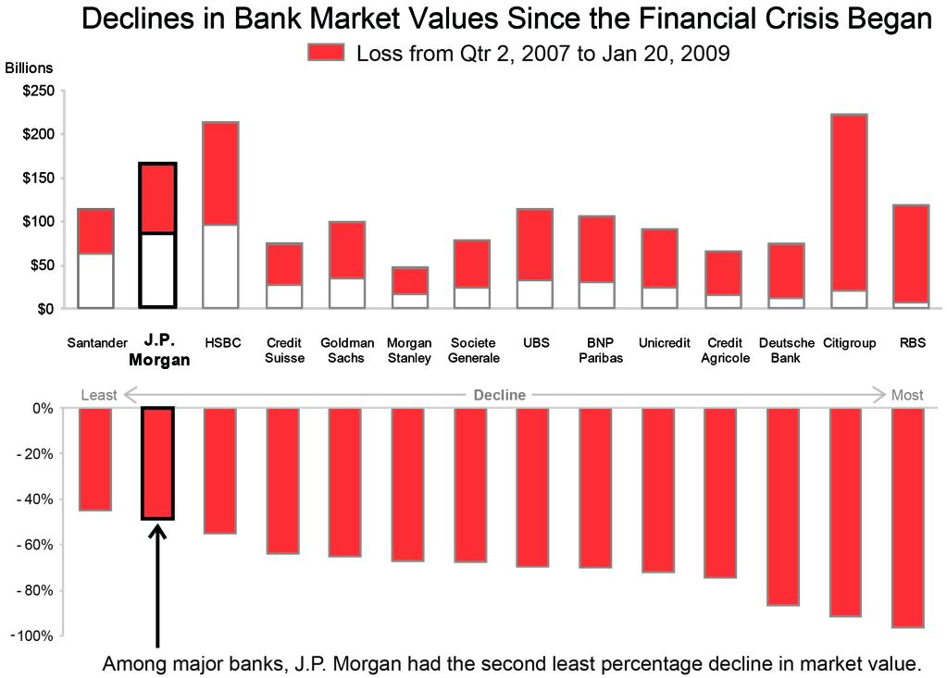
A picture is worth a 1,000 words …
Figure from Stephen Few http://perceptualedge.com/example18.php

Slide 7
What is data visualization?
“Data visualization is the presentation of data in a pictorial or graphical format.” – SAS Corporation.
“The main goal of data visualization is to communicate information clearly and effectively through graphical means.” – Friedman (2008) "Data Visualization and Infographics”.
Data visualization is the study of the visual representation of data, meaning "information that has been abstracted in some schematic form, including attributes or variables for the units of information."

Slide 8
What is data visualization?
“Information visualization is the use of computer-supported interactive visual representations of abstract data to amplify cognition.” – Card, Mackinlay and Schneiderman (1999) Readings in Information Visualization: Using Vision to Think.
I would slightly modify it to say “… of abstract data to amplify cognition and communicate information .”

Slide 9
What is data visualization?
“Visualization doesn't happen on a page or on a screen. It happens in the viewer's brain.” – Robert Spence, Information Visualization.
Insights from cognitive psychology are important!
A couple of excellent TED talks that illustrate what good visualizations are:
https://www.ted.com/talks/david_mccandless_the_beauty_of_data_visualization
https://www.ted.com/talks/hans_rosling_the_best_stats_you_ve_ever_seen

Slide 10
Exploration vs. Presentation
Our definition of data visualization highlights its two main roles:
Amplify cognition (Exploration): how do we find hidden patterns in data, facts worth highlighting that are not obvious by simply looking at data.
Communicate information (Presentation): once we have found interesting patterns, how do we make other people aware of them?
The two tasks are interrelated, but they sometimes require slightly different tools.

Slide 11
Exploration vs. Presentation
Exploratory data analysis (EDA) has a long history in statistics. EDA displays support “data exploration” to find facts of potential interest in a set of data, and “data sense-making” (a.k.a., data analysis or descriptive statistics) to determine what the facts mean. Understanding is the immediate goal of these activities. The ultimate goal is to improve decisions and the actions that follow.

Slide 12
Exploration vs. Presentation
Narrative displays are used to inform, explain, or persuade. Narrative (story) is an explanation. It answers questions: “How did we get to this state?” “What caused this to happen?” Its primary goal is communication, resulting in understanding and informed decisions.

Slide 13
Are there situations where a table is better than a graph?
Yes, but these are relative exceptions.
To convey a handful of numbers.
To report precise values for lookup.
To present many different types quantities (dimensions) for a small number of cases.
Tables are usually a bad idea if comparison is important.
I will not discuss principles of table design, but they are similar to the ones for visualization!

Slide 14
Visualization vs. Infographics
By a visualization we mean a single (possibly very complex) figure.
We will use the term “infographic” (short for “information graphic”) to refer to a collection of related graphical displays of data that tell a coherent story about a theme.
Infographics can contain text, but words are there to supplement the images, not the other way around.

Slide 15
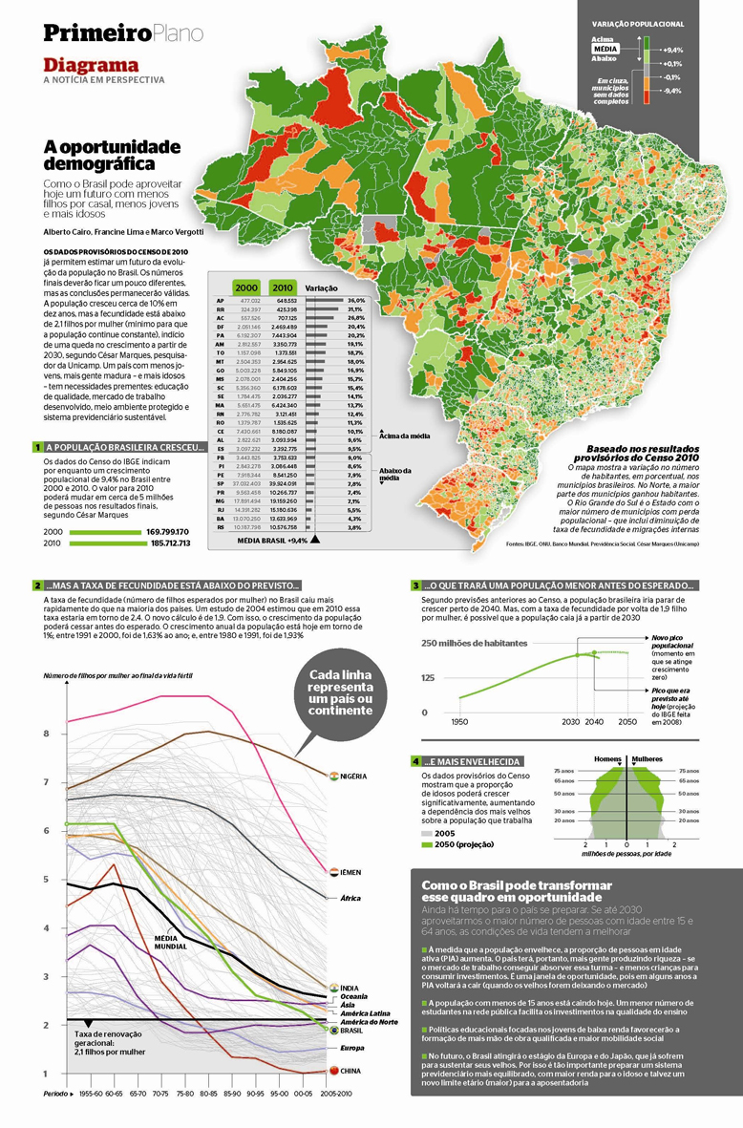
A great data infographic!
Graph from Alberto Cairo, The functional art, Figure 8.7

Slide 16
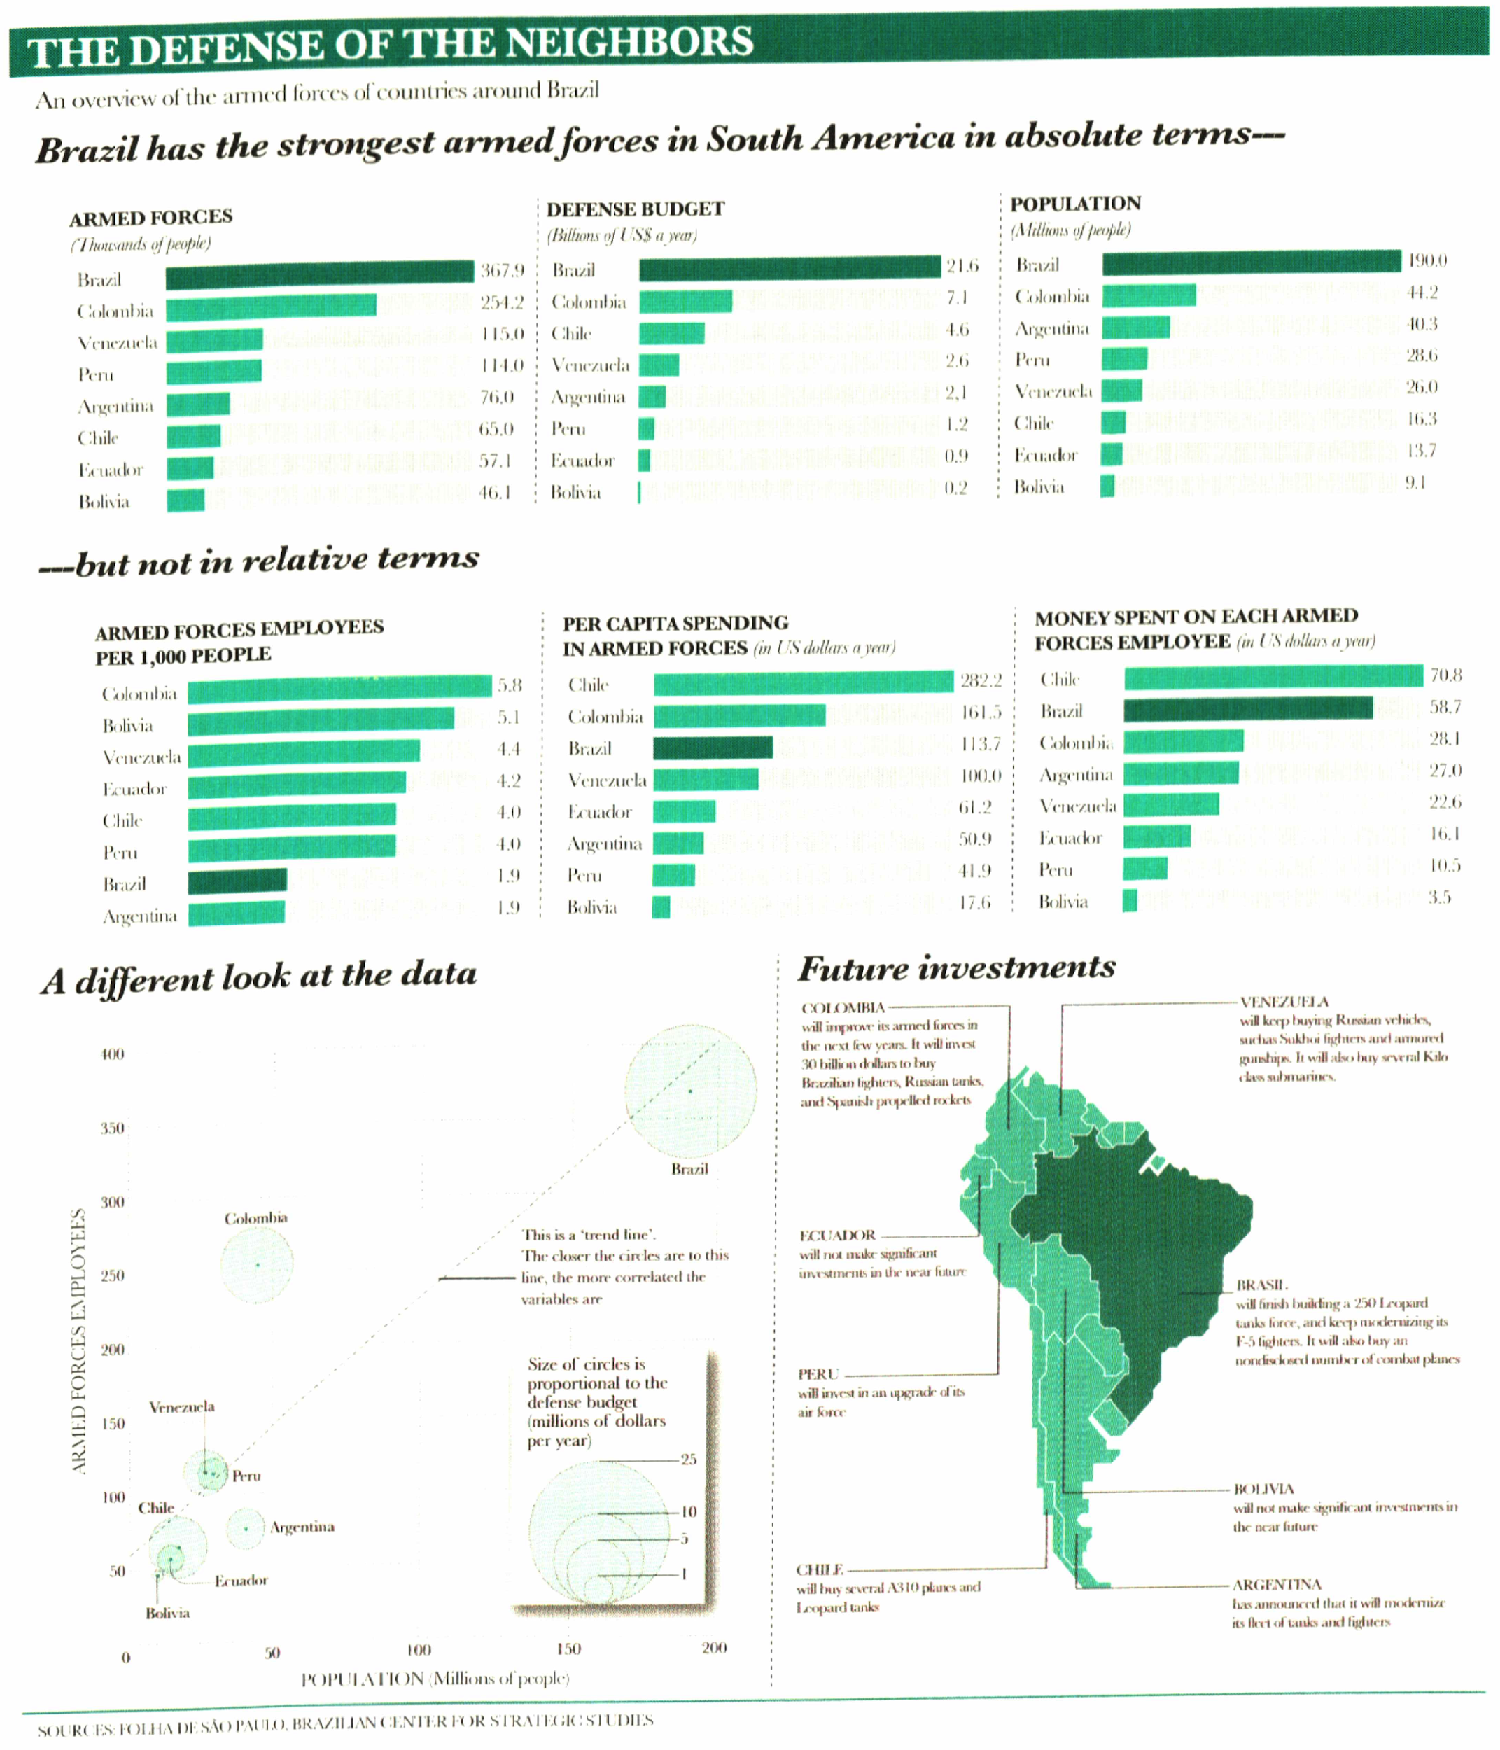
Another great
data infographic!
Graph from Alberto Cairo, The functional art, Figure 2.5

Slide 17
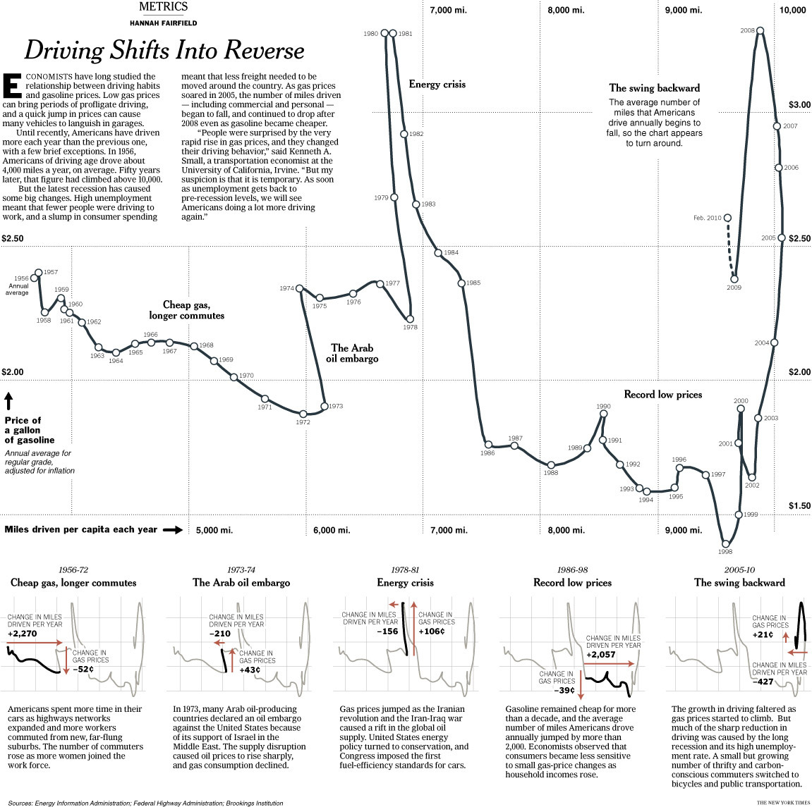
Another great
data infographic!
(but probably not
enough for this
class).
Regional trends?
Electric vehicles?
What has happened in the
rest of the world?
Graph from Alberto Cairo, The functional art, Figure 8.8

Slide 18
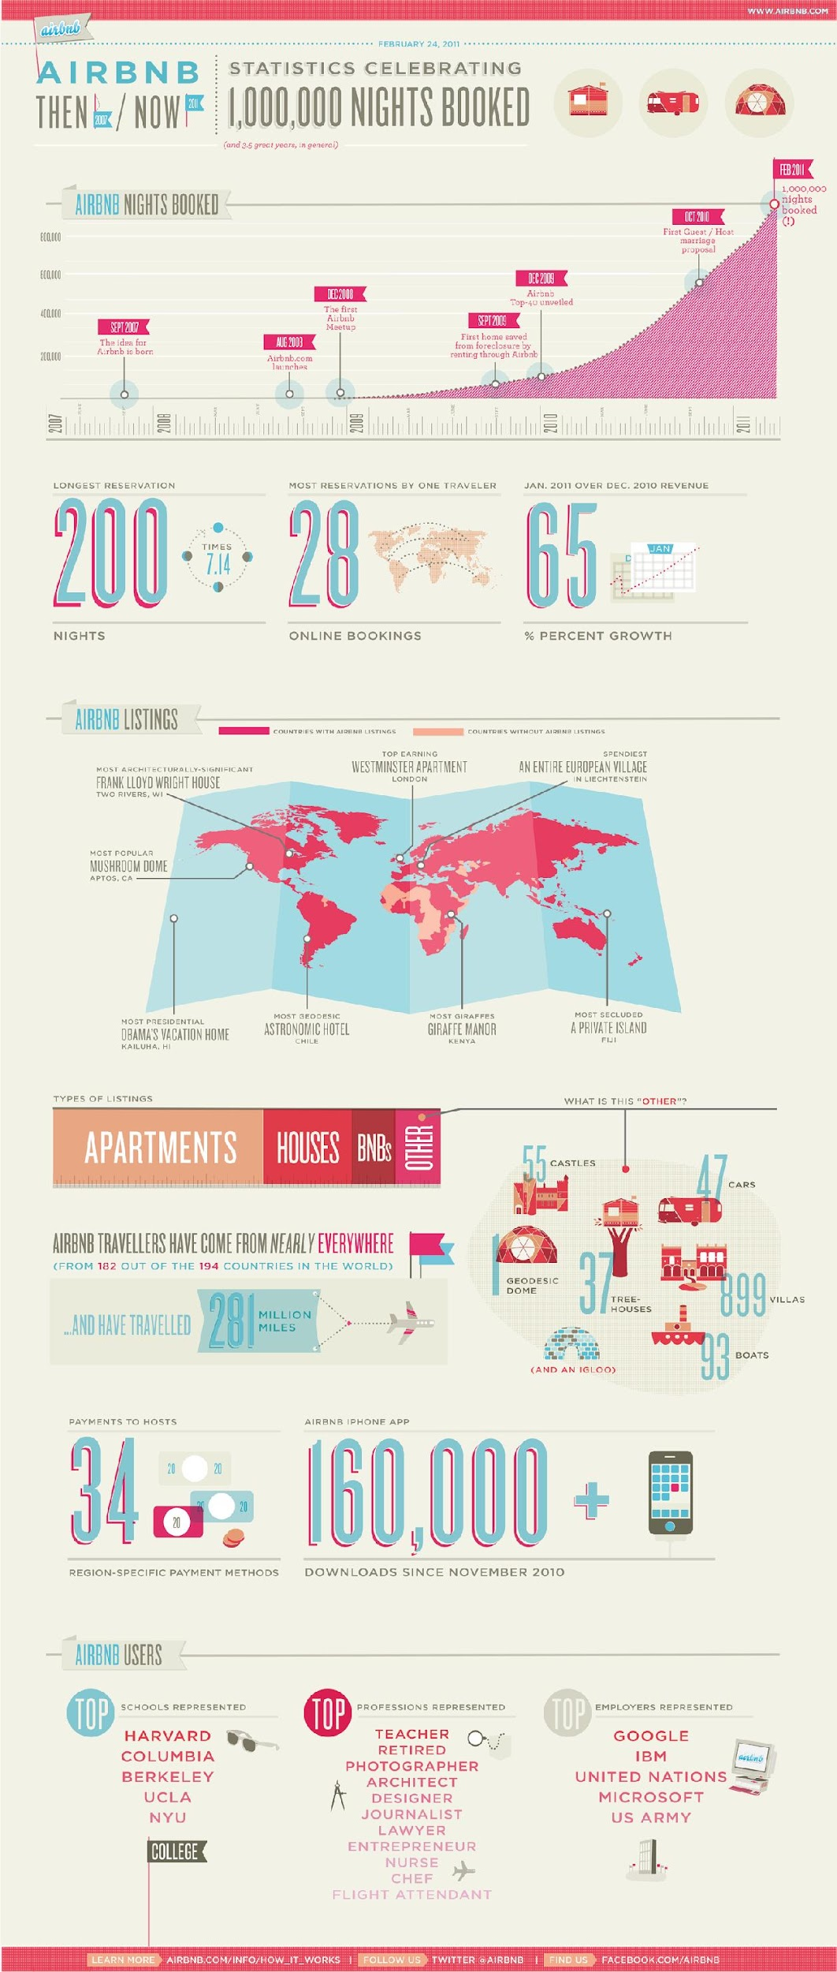
An OK but not great infographic.
Current map might be hard to read (unnecessary 3D perspective).
Map could provide more information (e.g., # of listings divided by total population).
Data on more common visitors to certain countries.
Scale is missing from types of listings
In summary: High ink/data ratio and too many bells and whistles.
Source: https://techcrunch.com/2011/02/24/airbnb-hits-1-million-nights-booked-as-european-clone-emerges/

Slide 19
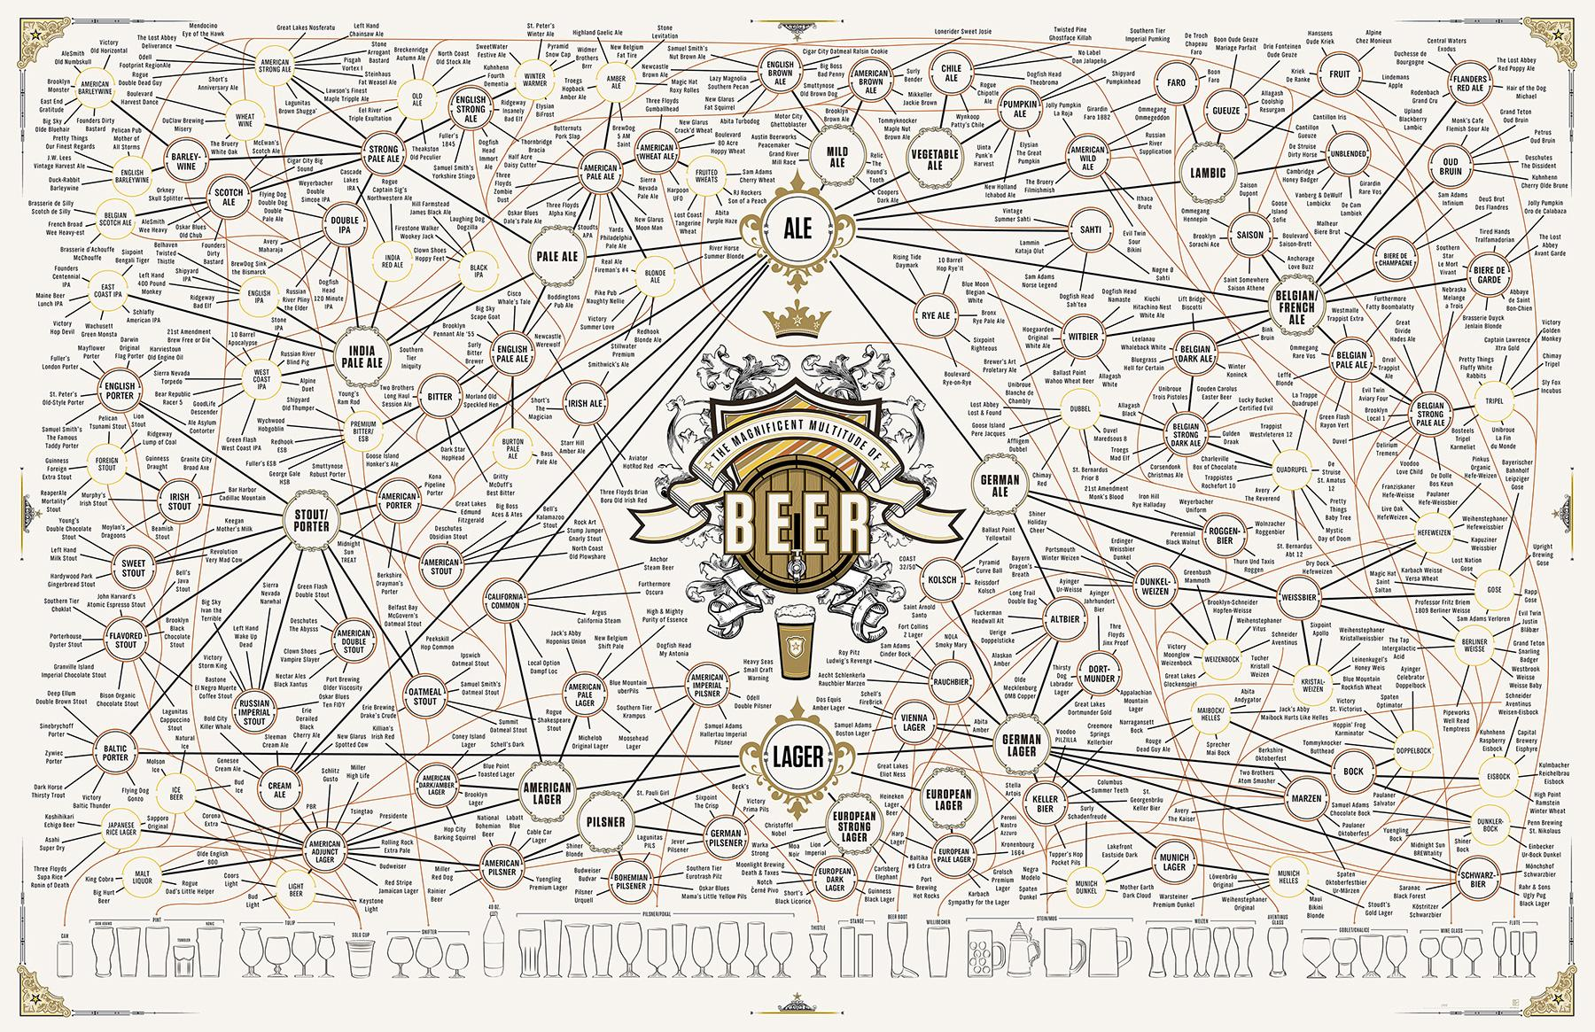
A beautiful work of art, but not appropriate for this class
Source: https://coolinfographics.com/blog/2013/10/14/the-magnificent-multitude-of-beer.html
Notes:
How are the links created?

Slide 20
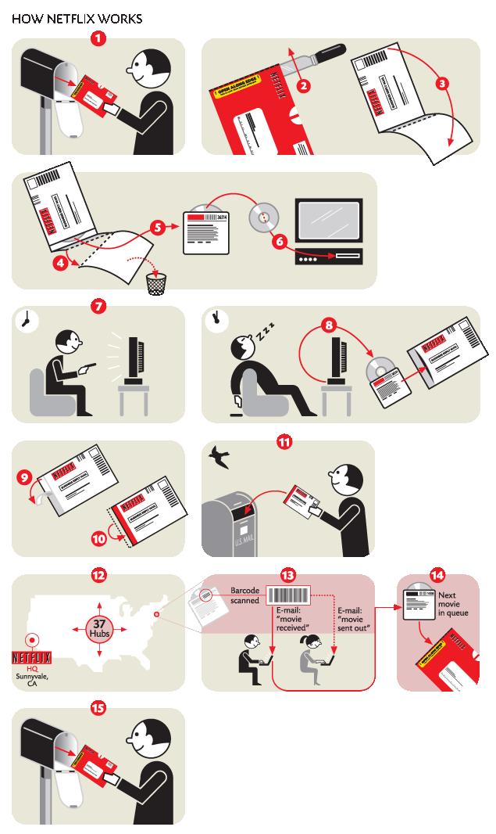
Technically an infographic, but
not the type we care about!
Source: https://nigelholmes.com/wp-content/uploads/2016/09/netflix.png
Notes:
How are the links created?

Slide 21
A (Very) Short History of Visualization
Descartes in 1637 first uses 2D grids to visually encode numbers as grid coordinates.
William Playfair published “The Commercial and Political Atlas” 1786 , which uses bar charts, line graphs and histograms to describe the economy of England.
In 1855 John Snow (not the guy from GoT!) uses maps to link the 1854 London cholera epidemic to contaminated drinking water.

Slide 22
A (Very) Short History of Visualization
Florence Nightingale in 1857 used a combination of stacked bar and pie charts to persuade Queen Victoria to improve conditions on British military hospitals.
Otto Neurath and colleagues devise the Vienna Method for pictorial statistics in the 1920s.
For a full historical account, see “Visual Language” by Robert E. Horn (1998).

Slide 23
A (Very) Short History of Visualization
Darrel Huff – How to Lie with Statistics (1954).
Edward Tufte – Visual Displays of Quantitative Information (1983).
William Cleveland – The Elements of Graphing Data (1994).
Stephen Few – Show me the Numbers (2004).
Renewed interest over the last decade has led to a profusion of material (a lot of it on the web).

Slide 24
Visualization and Computers
The advent of cheap desktop computers revolutionized the field of data visualization.
We can easily deal with large amounts of data.
Automation of basic functions speeds up the development of visualizations.
Nowadays, nobody does calculations or visualizations by hand anymore …

Slide 25
Visualization and Computers
A number of different types of software can be used for visualization:
Spreadsheets (e.g., Microsoft Excel): Easy to use but not flexible.
Online software: (e.g., manyeyes): Easy to use, more variety than spreadsheets, but not flexible.
GIS software (e.g., ArcView, Google Maps): Powerful but narrow.
Pearl, Java, Python, Matlab, R: Very powerful, but somewhat steeper learning curve.

Slide 26
Visualization and Computers
In this course we will be using R:
Powerful packages,
Customization options,
Integration with data analysis,
Ability to produce high-quality, reproducible graphics,
Interactivity and dashboards,
Documentation,
Open-source.

Slide 27
The interplay between visualization and art
The relationship between visualization and art is similar to the relationship between journalism and literature:
While literature and the arts don’t need a purpose beyond aesthetic pleasure, both journalism and visualization also aspire to accomplish other goals (in our case communicate and explain) which take precedence to beauty.
I suggest reading the article
http://www.perceptualedge.com/articles/visual_business_intelligence/information_visualization_and_art.pdf

Slide 28
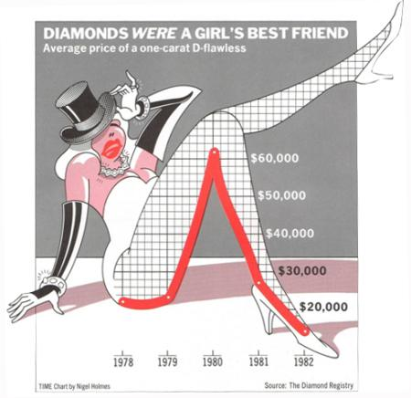
Multiple perspectives on data visualization
The two traditional camps are the “technical” vs. the “artistic”: Tufte, Holmes and the “Chartjunk” controversy.
I recommend reading:
http://www.perceptualedge.com/articles/visual_business_intelligence/the_chartjunk_debate.pdf
http://www.perceptualedge.com/articles/visual_business_intelligence/visual_difficulties.pdf
Chart by Nigel Holmes for Time Magazine

Slide 29
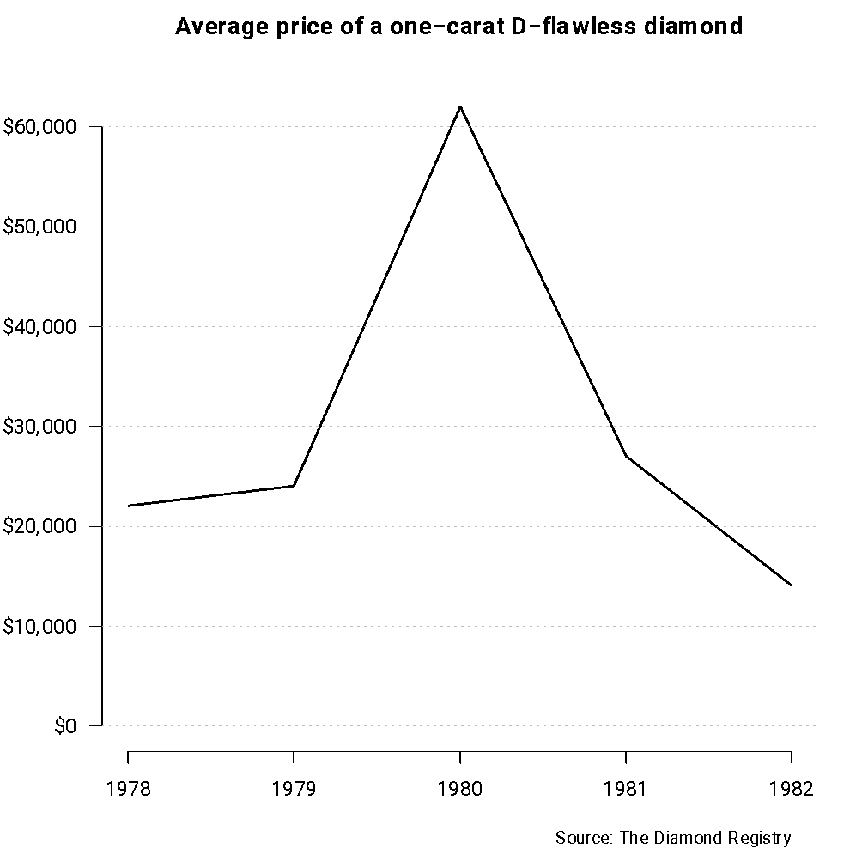
Multiple perspectives …
Original graph
Minimalist version
Chart by Nigel Holmes for Time Magazine
Graph from Alberto Cairo, The functional art, Figure 3.15
Note that the original graph
suggests a drop in price mid 1978

Slide 30
Is “chartjunk” useful? …
Randomized experiments in which both types of graphs are shown to two different groups of people suggest that both are equally effective at conveying the underlying message, but that “chartjunk” graphs can be easier to recall!
This is probably the case for unidimensional graphs, but probably not for more complex examples.

Slide 31
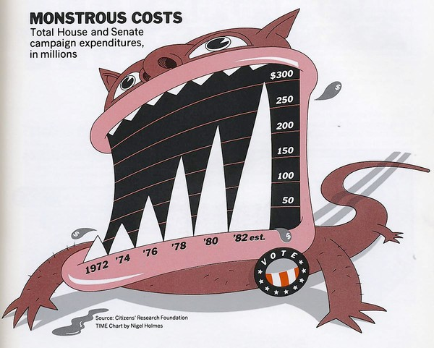
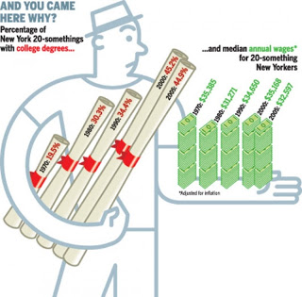
Other examples of “Chartjunk”
There is something very wrong with both charts … Can you tell what?
Source: https://eagereyes.org/blog/2010/chart-junk-considered-useful-after-all
http://1styeargraphics.blogspot.com/2010/10/wordless-diagrams-by-nigel-holmes.html

Slide 32
Other examples of “Chartjunk”
The use of decorative figures is not necessarily wrong. However:
The use of curved lines (plot on the left) or inclined bars (plot on the right) makes comparisons very difficult because the human brain is not as good at dealing with these as it is with straight horizontal/vertical lines.
It is impossible to draw conclusions from the 3D green bars (plot on the right) without looking at the numbers.

Slide 33
Insights from multiple disciplines …
Graphic design: Emphasizes aesthetics.
Computer science: Emphasizes algorithms.
Cognitive psychology: Provides insights into the most effective tools.
Journalism: Emphasizes storytelling.
Statistics: Emphasizes transmission of information.

